Slide 1
Welcome to our Policy and Practice Forum: Health, Parenting and Family Violence.
PROF Cathy Humphreys; a/prof Lena Sanci; PROF Kelsey Hegarty
chief investigators, Safer families CRE
Notes:
Acknowledgement of traditional owners
First policy and services forum
Introduce Zofia and Zophia to introduce herself – we will be wrapping up at the end of the afternoon
A packed agenda

Slide 2
Stakeholders here today…
Survivors
Community
WEAVERS
Lived experience
Health services
Inner North West Primary Care Partnership
Mercy Health
North East Health Communities
Peninsula Health
Family and Women’s services
1800 RESPECT
Anglicare
ASRC
Berry St
Safe steps
WESNET
WRISC
WAYYS
Drummond St
EDVOS
National Homeless Collective
No To Violence
Ozchild Family Services
Children’s Protection Society
Women’s Legal Service
Researchers
University of Melbourne
MCRI
LaTrobe University
AIFS
RMIT
Safer Families CRE
Policy makers
DHHS
DEET
Family Safety Victoria
Moonee Valley City Council
Sustainable Australia
Other
Metropolitan Fire Brigade
Urbis
To Be Loved Network
Notes:
Wonderful to have cross sector representation
Show of hands for health services and then family and women’s services
Introduce Kelsey

Slide 3
A bit about us…
who we are
A national and international collaboration funded for 5 years by the NHMRC (2017 –2022)
Researchers, families and communities, policy-makers, practitioners, community organisations and health, family and women’s services.
Our aim
“We aim to make all families safer by generating evidence-informed knowledge to assist services to identify violence early and tailor effective responses”.
Notes:
Kelsey

Slide 4
What keeps us busy…
What we do
We research the health effects of domestic violence and the health sector responses needed to improve the safety, health and well-being of families. Our research:
> Explores the dynamics of abuse and resilience.
> Tests clinician early identification of abuse and first line responses.
> Develops and tests child, parent and carer programs.
Our focus
With respect for the diversity of Australian families, our work centres on early intervention with children, young people and their parents, Aboriginal and Torres Strait Islander communities, and men who use violence in their relationships.

Slide 5
Research design
The Share Project
Shared Understanding of Knowledge Translation in an Interdisciplinary Research Network
Research questions
How is a shared understanding of knowledge translation developed in an interdisciplinary research network?
How does the implementation of knowledge translation support strengthen an interdisciplinary research network to influence policy and practice?
How does engaging lived experience participants enhance knowledge translation in an interdisciplinary research network?
Step 2 - Develop support guide
Step 1 - Review of model
Research network
Step 3 - Engage research network and consumers
Step 4 - Implement knowledge translation support
Step 5 - Case study
The study aims to implement an innovative realist approach to knowledge translation with an interdisciplinary research network.
Notes:
My name is JC and I am very pleased to be here today to briefly give a three minute outline of my PhD project and how it will support the Safer Families Centre of Research Excellence.
The aim of the study is to implement a novel approach to knowledge translation with an interdisciplinary research network. The research network is the SFCRE.
RESEARCH QUESTIONS – talk about question 2
Kelsey (and others) has provided you with an overview of the fantastic work being done by the network – my job is to help the CRE develop their KT capacity and get this great work into policy and practice !
I have always had a strong interest in KT especially the impact it can have on the ‘front line’ so the opportunity to do a PhD on this topic is fantastic !
As you may know there has been an explosion of literature over the past ten years regarding KT - however it is all a bit of a mixed bag.
With this in mind I have completed what is called a ‘realist review’ to help me identify the most appropriate model of KT//DV for the network.
The results of my review have highlighted a real gap in the literature regarding the KT/DV research especially in regards to policy makers and voices of consumers or lived experience.
However, my PhD will aim to fill this gap !
Briefly the plan is too undertake the following:- TALK BRIEFLY ABOUT THE FIVE STEPS
So, I hope there will be further opportunity for me to engage with policy throughout this journey and potentially also engage your feedback on the support guide as it develops.
I have a handout if you have not see it already that provides further details of the study and my contact details if you are interested.

Slide 6
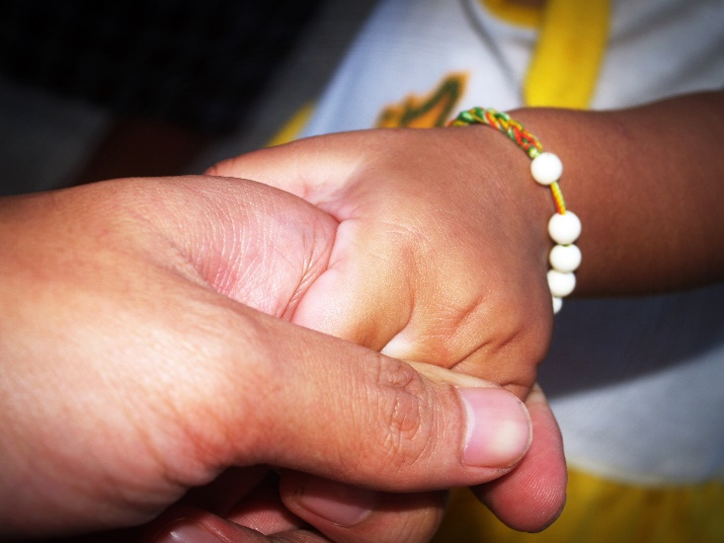
Today’s forum
AIMS of policy and practice engagement
To strengthen links between the CRE, those working in health and family policy and services and those affected by domestic and family violence.
To facilitate knowledge exchange across these groups.
To inform and shape research, policy and programs for early intervention and first line response to domestic and family violence.
TODAYS FOCUS
Child-Parent interventions
Early intervention in the health setting
Application and problem solving in policy everyday practice
Notes:
Lena
Flag here that the next forum in SA will have a strong Aboriginal theme – watch this space

Slide 7
Why this focus…
CURREnt landscape
Referral pathways from health into child-parent programs can be unclear and inaccessible
Particularly problematic when few programs designed for fathers who use violence, early intervention, or mother-child strengthening after violence
Health system not necessarily equipped for awareness, identification and tailored response to family violence
FV focus has been on crisis rather than early intervention or healing
CRE tackling these issues and particularly the role that health can play in early intervention

Slide 8
Let’s get talking…
SESSION ONE: Child-Parent Interventions
Aim of session is to
Understand the research and context – Poster presentation: 5 mins
Identify needs and issues, share ideas – Discussion in small groups: 10 mins
INTERVENTIONS
Recover Psychotherapy intervention for reconnecting mothers and children after violence.
Presenter: Leesa Hooker
Family Foundations Home visiting intervention for first-time expectant couples.
Presenter: Rebecca Giallo
Caring Dads Group intervention program for fathers who use violence in the home. Presenter: David Gallant
Children & Mothers in Mind Mother-child group program for mothers who have experienced DV.
Presenter: Margaret Kertesz

Slide 9
Instructions for poster sessions
Please go to poster that corresponds with your colour dot.
15 mins has been allocated to each intervention program.
5 mins presentation followed by 10 mins discussion.
When bell rings, move anti clockwise to next poster.
Opportunity to engage in 4 different poster sessions.
After the break at afternoon tea, there will be another 3 rotating sessions.

Slide 10
Round 2 of discussions…
SESSION two: early Intervention in health
Aim of session is to
Understand the research and context – Poster presentation: 5 mins
Identify needs and issues, share ideas – Discussion in small groups: 10 mins
INTERVENTIONS
Better Man Online early intervention tool for engaging men who use violence, to seek help.
Presenter: Laura Tarzia
My Safety App Online app to support children experiencing family violence.
Presenter: Anita Morris
SUSTAIN Sustainability of identification and response to family violence in antenatal care. Presenter: Kelsey Hegarty

Slide 11
Key messages
Group discussion
What will you take from today?
How will you implement in your own work? (What else do you need?)

Slide 12
What’s next?
Group discussion:
Early intervention in health and family services space
What new research questions would you like to see us answering to solve your policy and practice issues?

Slide 13
Next steps…
Policy and practice network
Continued engagement
Policy and practice forum 2019
Aboriginal and Torres Strait Islander focus
International Domestic Violence and Health Conference
Tuesday 20th and Wednesday 21st November 2018
RACV City Club
Register now

Slide 14
Reflections

